Slide 1

软件工程专业英语
计算机科学学院
School of Computer Science
Unit 10：Beginning Your Work

Slide 2
Outline
Part 1, Dialogue: Beginning Your Work
Part 2, Translating: Google Glass

Slide 3
Part 1, Dialogue: Beginning Your Work
Main content
Kevin到Expansion公司第一天上班的情况
受到同事的欢迎
了解公司文化
了解具体的工作任务
与同事交流一天的工作感受

Slide 4
(Congratulations on Kevin becoming a new employee as a programmer in the Information System Department of Expansion Company! Today is his first day for work. There will be some new colleagues and fresh working environment coming along with him)
Kevin: Nice to meet you, Mr. John. My name is Kevin Li, and I'd like to report for work.
Mr. John (the CTO of Expansion): Welcome to our company, Kevin. You'll work in the Information System Department. Ok, now please let me introduce our colleagues to you.
(Kevin comes into the office following Mr. John.)
Notes:
skeptical 英 [ˈskeptɪkl] 美 [ˈskeptɪkl] adj.怀疑的

Slide 5
Mr. John: Hello, everybody. Today I'd like to introduce a new colleague to you. His name is Kevin Li and he will work with you from today.
Kevin: How do you do?
A, B, C: How do you do? Mr. Li, welcome!
Kevin: Thanks! I have just graduated. This is my first time working in a multinational company. I hope you can help me adapt from school life to working in a professional environment.
adapt to/adapt oneself to 适应
1. The world will be different, and we will have to be prepared to adapt to the change
世界会变得不同，我们必须做好准备以适应其变化。
2. The network framework with good scalability can adapt to complexity and heterogeneity of grid resources.
通过对网络架构的分析，该模型能够适应网格资源的复杂性与异构性，可扩展性好。
Notes:
skeptical 英 [ˈskeptɪkl] 美 [ˈskeptɪkl] adj.怀疑的

Slide 6
A: No problem, Mr. Li. I'm Jenny, in charge of the office work. This is your desk.
Kevin: Thank you very much, Ms. Jenny.
A: You call me Jenny. Everybody in our company is called by his or her first name. It's been our tradition since the company was established.
Kevin: OK, I'll try.
B&C: Very glad to know you. We believe we will be able to cooperate well in the future.
Kevin: So do I.
Mr. John: Kevin, if you have any questions please feel free. The people here are all very kind. Any other questions?
feel free 请随意; 不必拘谨
1. Please feel free to get in touch with me on any issue related to this recommendation.
如对我的推荐有任何疑问，请随时与我联系。
2. So please test the script and feel free to reply with bugs and comments.
所以，请测试该脚本，并随时回复错误和意见。
Notes:
skeptical 英 [ˈskeptɪkl] 美 [ˈskeptɪkl] adj.怀疑的

Slide 7
Kevin: All right. By the way, excuse me. Would you please tell me what my specific tasks and responsibilities are?
Mr. John: You'll spend most of this week to get familiar with the work in the office and read some documents about a project which you will participate in from the next week. Do you have any other questions?
Kevin: Not yet, but I'm sure I will have more questions later. Thanks.
(It is time for ringing out after have been working for a whole day.)
get familiar with 熟悉
1. You can expand objects in this page and get familiar with their structure.
可以在这个页面中展开对象，熟悉它们的结构。
2. You still need to get familiar with the Swing API docs to make proper use of the Swing components.
为了恰当地使用Swing组件，仍然需要熟悉Swing API文档。
Notes:
skeptical 英 [ˈskeptɪkl] 美 [ˈskeptɪkl] adj.怀疑的

Slide 8
Jenny: Kevin, you've been working for nearly one day. How do you feel about the job?
Kevin: Not bad. Thank you for your help. I've been busy all day and feeling a bit tired.
Jenny: I had the same feeling when I first came to work here. But after a period of time, I felt much better. I'm sure you'll get used to the job.
Kevin: I also feel that the work efficiency is very high and it is also challenging. Everybody here works hard and they are cooperative. And you all have strong capabilities and professional skills. I really like such a working environment.
get used to 习惯于
1. It's a nice country if you get used to it. 如果你习惯了，这将是个很美的国家。
2. I get used to looking after myself. 我已经习惯于照顾自己了。
Notes:
skeptical 英 [ˈskeptɪkl] 美 [ˈskeptɪkl] adj.怀疑的

Slide 9
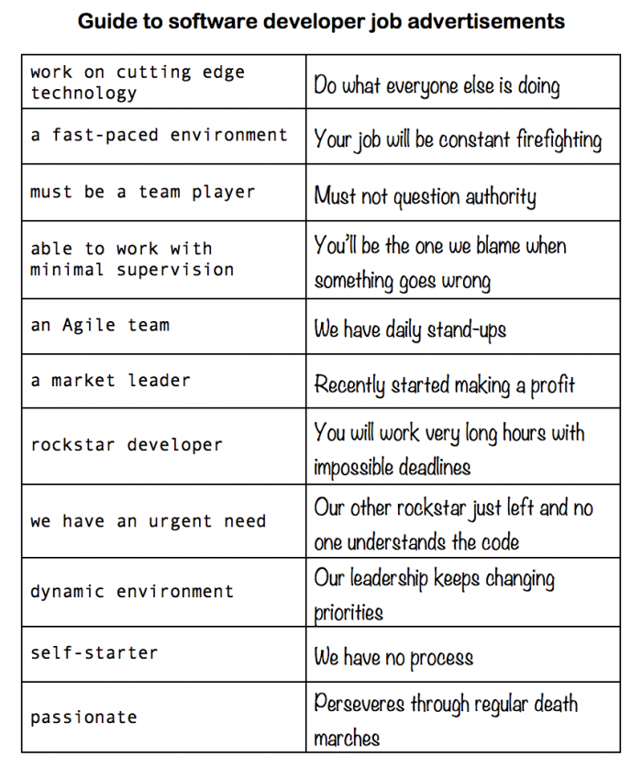

Slide 10
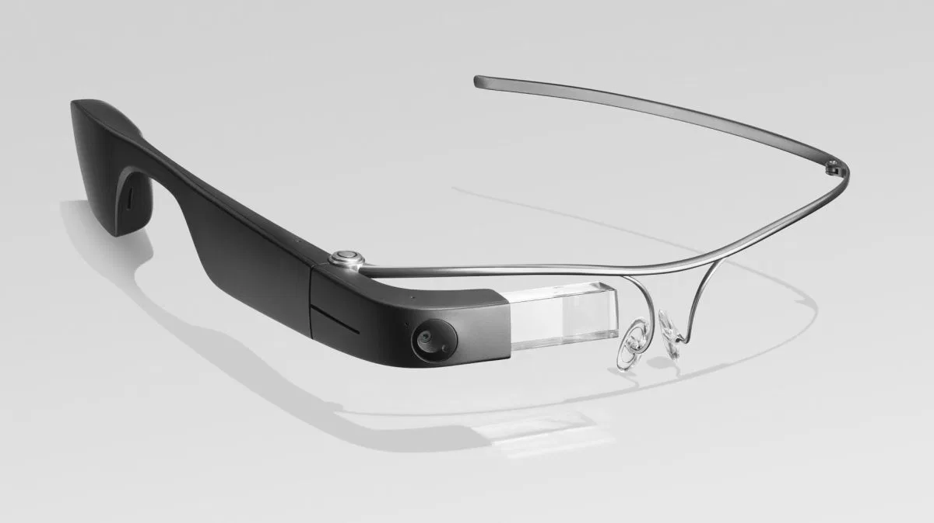
Outline
Part 1, Dialogue: Beginning Your Work
Part 2, Translating: Google Glass

Slide 11
The first two paragraphs
Google Glass is an attempt to free data from desktop computers and portable devices like phones and tablets, and place it right in front of your eyes.
Essentially, Google Glass is a camera, display, touchpad, battery and microphone built into spectacle frames so that you can perch a display in your field of vision, film, take pictures, search and translate on the go.
portable device 便携设备
spectacle frame 眼镜框
perch [pɜːrtʃ] v. 栖息; 停留; 坐在…边沿; 置于(顶上或边上)
1. She perched herself on the edge of the bed. 她坐在床沿上。
2. St. John's is a small college perched high up in the hills.
圣约翰学院是一所位于山顶的小学院。
1. I got a new job this year where I am on the go all the time.
我今年找了份新工作，一直忙得不可开交。
2. Moreover, thanks to mobile devices, you can participate "on the go".
而且，有了移动设备，您可以随时随地参加学习。
on the go 忙碌; 活跃

Slide 12
The 3rd paragraph
The principle [原理] is one that has been around for years in science fiction, and more recently it’s become a slightly clunky [粗笨的] reality. In fact, the “heads-up [头部的] display” putting data in your field of vision became a reality as early as 1900 when the reflector sight [反射瞄准镜] was invented.

Slide 13
The 4th paragraph
Google Glass uses display technology instead to put data in front (or at least, to the upper right) of your vision courtesy of a prism [棱镜] screen. This is designed to be easily seen without obstructing [妨碍] your view. According to Google the display is “the equivalent of a 25-inch high definition screen [高清晰度屏幕] from eight feet away”. There’s no official word on native resolution [标准分辨率] , but 640*360 has been widely mooted.
by courtesy of 蒙…的好意；由于…的作用
1. We went through the difficulty by courtesy of your kindness.
多亏了你的好心，我们才度过了难关。
2. This photo was reproduced by courtesy of the General Electric Company.
这张照片是承蒙通用电气公司许可而翻印的。
moot adj. （因不大可能发生而）无考虑意义的； v. 提出…供讨论，提出（问题）
1. He argued that the issue had become moot since the board had changed its policy.
他争辩说这项议题已变得毫无实际意义，因为董事会已经改变了政策。
2. When the theatre idea was first mooted I had my doubts.
第一次讨论剧院设想时，我就表示怀疑。

Slide 14
The 5th paragraph
Overlaying data into your vision has obvious benefits; many of which are already functional in Google Glass. Directions become more intuitive (although it sounds like there is no GPS on board so you will have to pair it with your phone), you can view real-time translations or transcriptions [抄写，转写，录用] of what is being said, and you can scroll through [滚动浏览] and reply to messages—all on the fly.
on the fly 匆忙地; 在飞行中; 动态地, 在线地
1. We had so little time to catch the train that we had to eat our lunch on the fly.
我们离上火车的时间不多了，所以不得不匆忙地吃午饭。
2. We build up such a data structure on the fly in the format routine, using the reverse command.
我们在format中使用reverse命令动态地构建了这样一个数据结构。

Slide 15
The 6th ~ 8th paragraphs
The embedded camera obviously does not need a viewfinder [取景器] because it is simply recording your first-person perspective, allowing you to take snaps [照片] or footage [连续镜头] of what you are actually seeing.
Any function that requires you to look at a screen could be put in front of you.
Controlling this data is the next neat [巧妙的] trick. With a microphone and touchpad on one arm of the frame, you can select what you want to do with a brief gesture or by talking to the device, and Google Glass will interpret your commands.

Slide 16
The 9th ~ 12th paragraphs
Google Glass can also provide sound, with bone-induction [骨诱导] technology confirmed. This vibrates your skull [颅骨] to create sound, which is both more grisly [恐怖的, 可怕的] sounding and much less cumbersome [笨重的, 复杂的，冗长的] than traditional headphones.
As well as Google‘s own list of features, the early apps for Google Glass provide a neat glimpse [一瞥，一看，短暂的感受/体验/领会] into the potential of the headset.
As well as photos and film—which require no explanation—you can use the Google hangout software [社交聚会软件] to video conference with your friends and show them what you're looking at.
You’ll also be able to use Google Maps to get directions, although with GPS absent from the spec list [规格列表], you’ll need to tether [栓住，束缚] Glass to your phone.

Slide 17
The 13th ~ 15th paragraphs
To do that, Google offers the MyGlass app. This pairs your headset with an Android phone. As well as sharing GPS data, this means messages can be received, viewed on the display, and answered using the microphone and Google's voice-to-text functionality.
Google has given its Glass project a big boost [提升] by snapping up voice specialists DNNresearch.
That functionality will also bring the ability to translate the words being spoken to you into your own language on the display. Obviously you‘ll need a Wi-Fi connection or a hefty [相当多的] data plan [流量套餐] if you're in another country, but it's certainly a neat trick if it works.
snap up 抢购，赶紧买下（便宜或心仪之物）
1. Every time we get a new delivery of clothes, people are queuing to snap them up.
每次新到一批服装时，人们都在排起长队来抢购。
2. According to Zheng Bin, director of HR at Baidu, companies in the Internet industry launched earlier campus recruitment campaigns this year in order to snap up fresh talent.
百度人力资源主管郑斌表示，为了争夺应届人才，今年很多网络公司都提前举行了校园招聘。

Slide 18
The last three paragraphs
Third parties are also already developing some rather cool/scary apps for Google Glass—including one that allows you to identify your friends in a crowd, and another that allows you to dictate an E-mail.
The New York Times app gives an idea how news will be displayed when it‘s asked for: a headline [头条，标题], byline [署名], appropriate image and number of hours since the article was published are displayed.
Other cool ideas include an air carrier’s [航空公司] suggestion that you could have flight details beamed [发射，发送] to you while you are waiting at the airport. Basically, the sky's the limit.
the sky is the limit 前途不可限量
For people who work hard at this company, the sky's the limit.
在这家公司努力工作的人会前途无量。

